Slide 1

Weather Prediction
Sudhansu Manutwal
23FS20MCA00059
AND
Parth Mishra
23FS20MCA00027
MASTER OF COMPUTER APPLICATIONS (MCA)
DEPARTMENT OF COMPUTER APPLICATIONS
MANIPAL UNIVERSITY JAIPUR
JAIPUR 303 007, RAJASTHAN, INDIA
2024

Slide 2
Table of Contents :
Introduction
Concept
Dataset
Methodology
Work Flow
Models
Visualization

Slide 3
Introduction :
Weather prediction is an essential aspect of modern society, influencing many aspects of our lives, including travel, agriculture, and public safety.
Regression analysis is a statistical technique that aims to predict future weather patterns based on historical data, such as temperature, humidity, wind speed, and precipitation etc.

Slide 4
Concept :
To demonstrate how to use linear regression and ridge regression model for predicting temperature values based on weather data.
To provide a practical guide for data scientists and machine learning practitioners who are interested in applying regression model to real-world data problems.

Slide 5
Dataset :
The dataset used is named as "weatherHistory.csv". It contains hourly weather data for a particular location.
The dataset has 96,529 rows and 12columns
Attributes Of the Dataset:-
      Formatted Date
      Summary
      Precip Type
      Temperature (C)
      Apparent Temperature (C)
      Humidity
      Wind Speed (km/h)
      Wind Bearing (degrees)
      Visibility (km)
      Cloud Cover
      Pressure(millibars)
      Daily Summary

Slide 6
Continued …
Dataset :
The unnecessary columns
Formatted Date
Summary
Precip Type
Daily Summary
Above mentioned columns were dropped.
Temperature (C)" was used as the target variable for predicting.
The remaining columns were used as features for the prediction model.
The data was collected from the Dark Sky API.

Slide 7
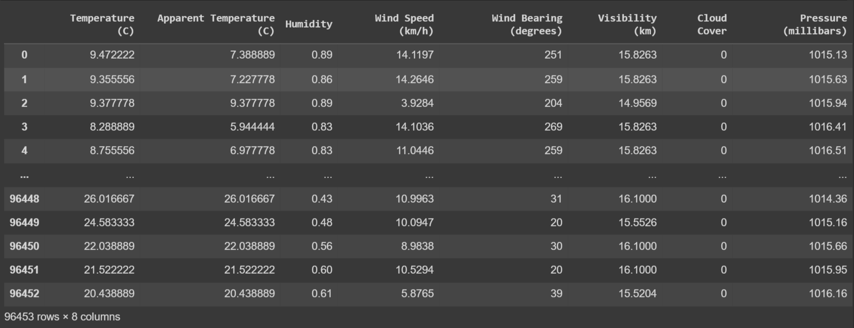
Some of the Data from Dataset :

Slide 8
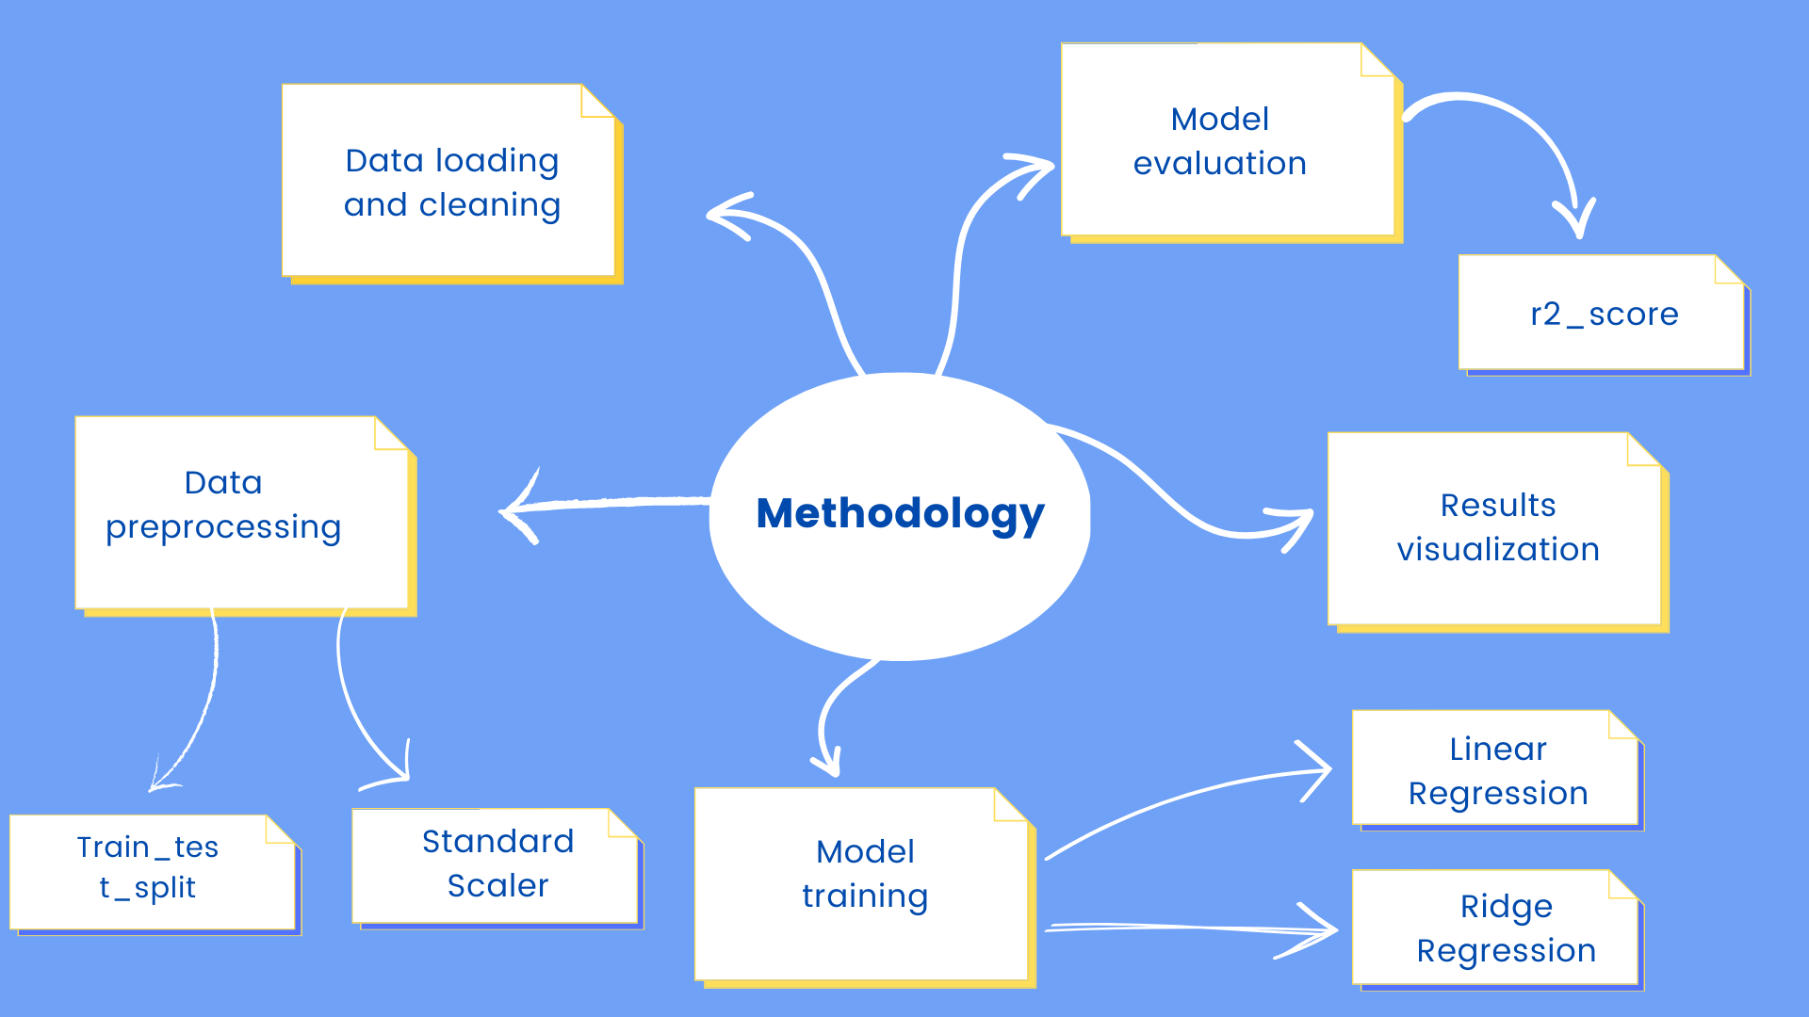
Review Methodology
.

Slide 9
Libraries Used :
pandas - For loading and manipulating the dataset.
sklearn.linear_model - For building linear regression and ridge regression model.
sklearn.model_selection - For splitting the dataset into training and test sets.
sklearn.metrics - For calculating the R-square score.
sklearn.preprocessing - for standardizing the dataset.
matplotlib.pyplot - For creating visualizations.
NumPy - To create a linear spaced array for plotting the line in the scatter plot.

Slide 10
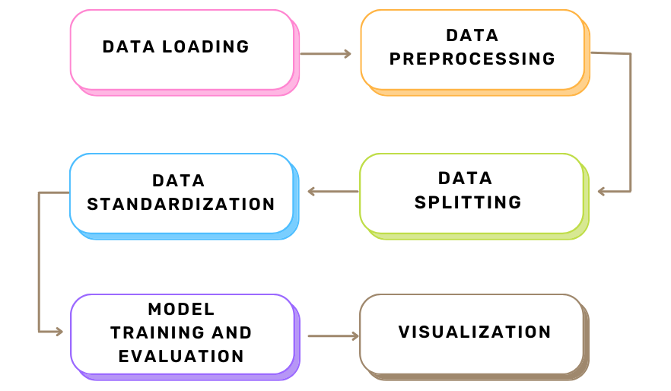
Work Flow :

Slide 11
Models :
Linear Regression – Linear regression is a statistical technique used to identify and model the linear relationship between a dependent variable and one or more independent variables. Linear regression can be used to make predictions, identify the strength and direction of the relationship between variables, and evaluate the significance of predictor variables
Ridge Regression - Ridge regression is a regularization technique used in linear regression to prevent overfitting and improve the stability of the model. Overall, ridge regression is a useful technique for improving the stability and accuracy of linear regression models, particularly when dealing with high-dimensional data with many correlated independent variables.

Slide 12
Overview on some of the terms
Terminologies :
Train-Test Split - It is a technique used to evaluate the performance of a machine learning model. The data is split into two sets, a training set and a testing set, where the model is trained on the training set and evaluated on the testing set
R-Squared Score - It is a statistical measure that represents the proportion of the variance in the dependent variable that is explained by the independent variables. It is used to evaluate the accuracy of a linear regression model.

Slide 13
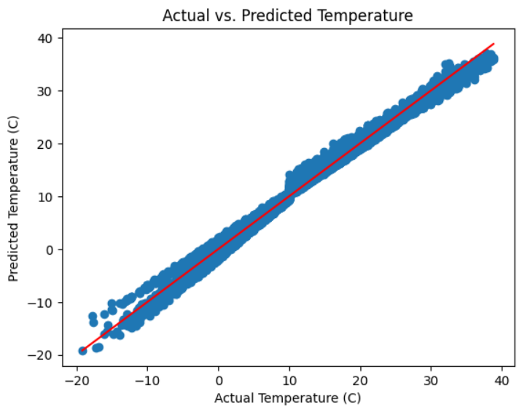
Visualization :
Linear Regression Plot : Actual vs. Predicted Temperature

Slide 14
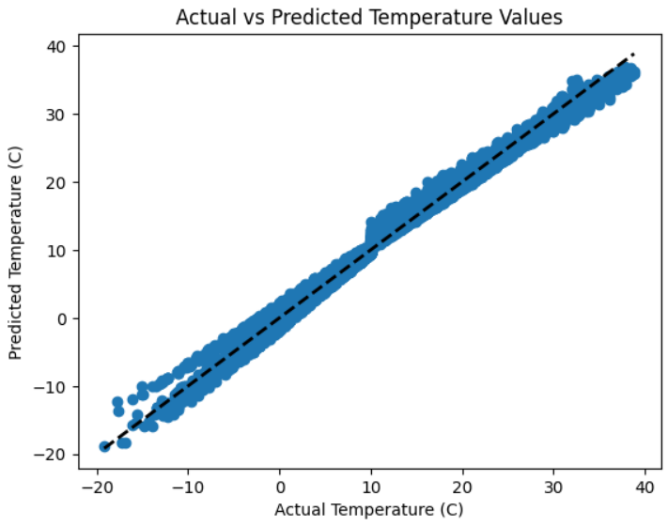
Continued…
Visualization :
Ridge Regression Plot : Actual vs predicted temperature

Slide 15
Conclusion :
Both Linear Regression and Ridge Regression models were used to predict temperature values based on weather data.
The Linear Regression model achieved a R-squared score of 0.9902437799520607 , indicating that it can explain about 99% of the variance in the temperature values. The Ridge Regression model achieved slightly higher score of 0.9902437951539114
The scatter plots of the actual vs. predicted temperature values showed a relatively strong positive correlation between both the models, but there were also some significant deviations from the ideal line of perfect predictions.
Overall, the Ridge Regression model performed slightly better than the Linear Regression model, but there is still room for improvement in the accuracy of the predictions.

Slide 16
Future Work :
Implement some more models.
Compare with existing work and develop the understanding to implement the different methodologies.
Improve the accuracy by understanding and implementing different methods of preprocessing.

Slide 17
References :
N. Singh, S. Chaturvedi and S. Akhter, "Weather Forecasting Using Machine Learning Algorithm," 2019 International Conference on Signal Processing and Communication (ICSC), NOIDA, India, 2019, pp. 171-174, doi: 10.1109/ICSC45622.2019.8938211.

Slide 18
Thank You!

